Slide 1
建構安全呼吸道維護醫院
曾稼志
2013 09 25

Slide 2
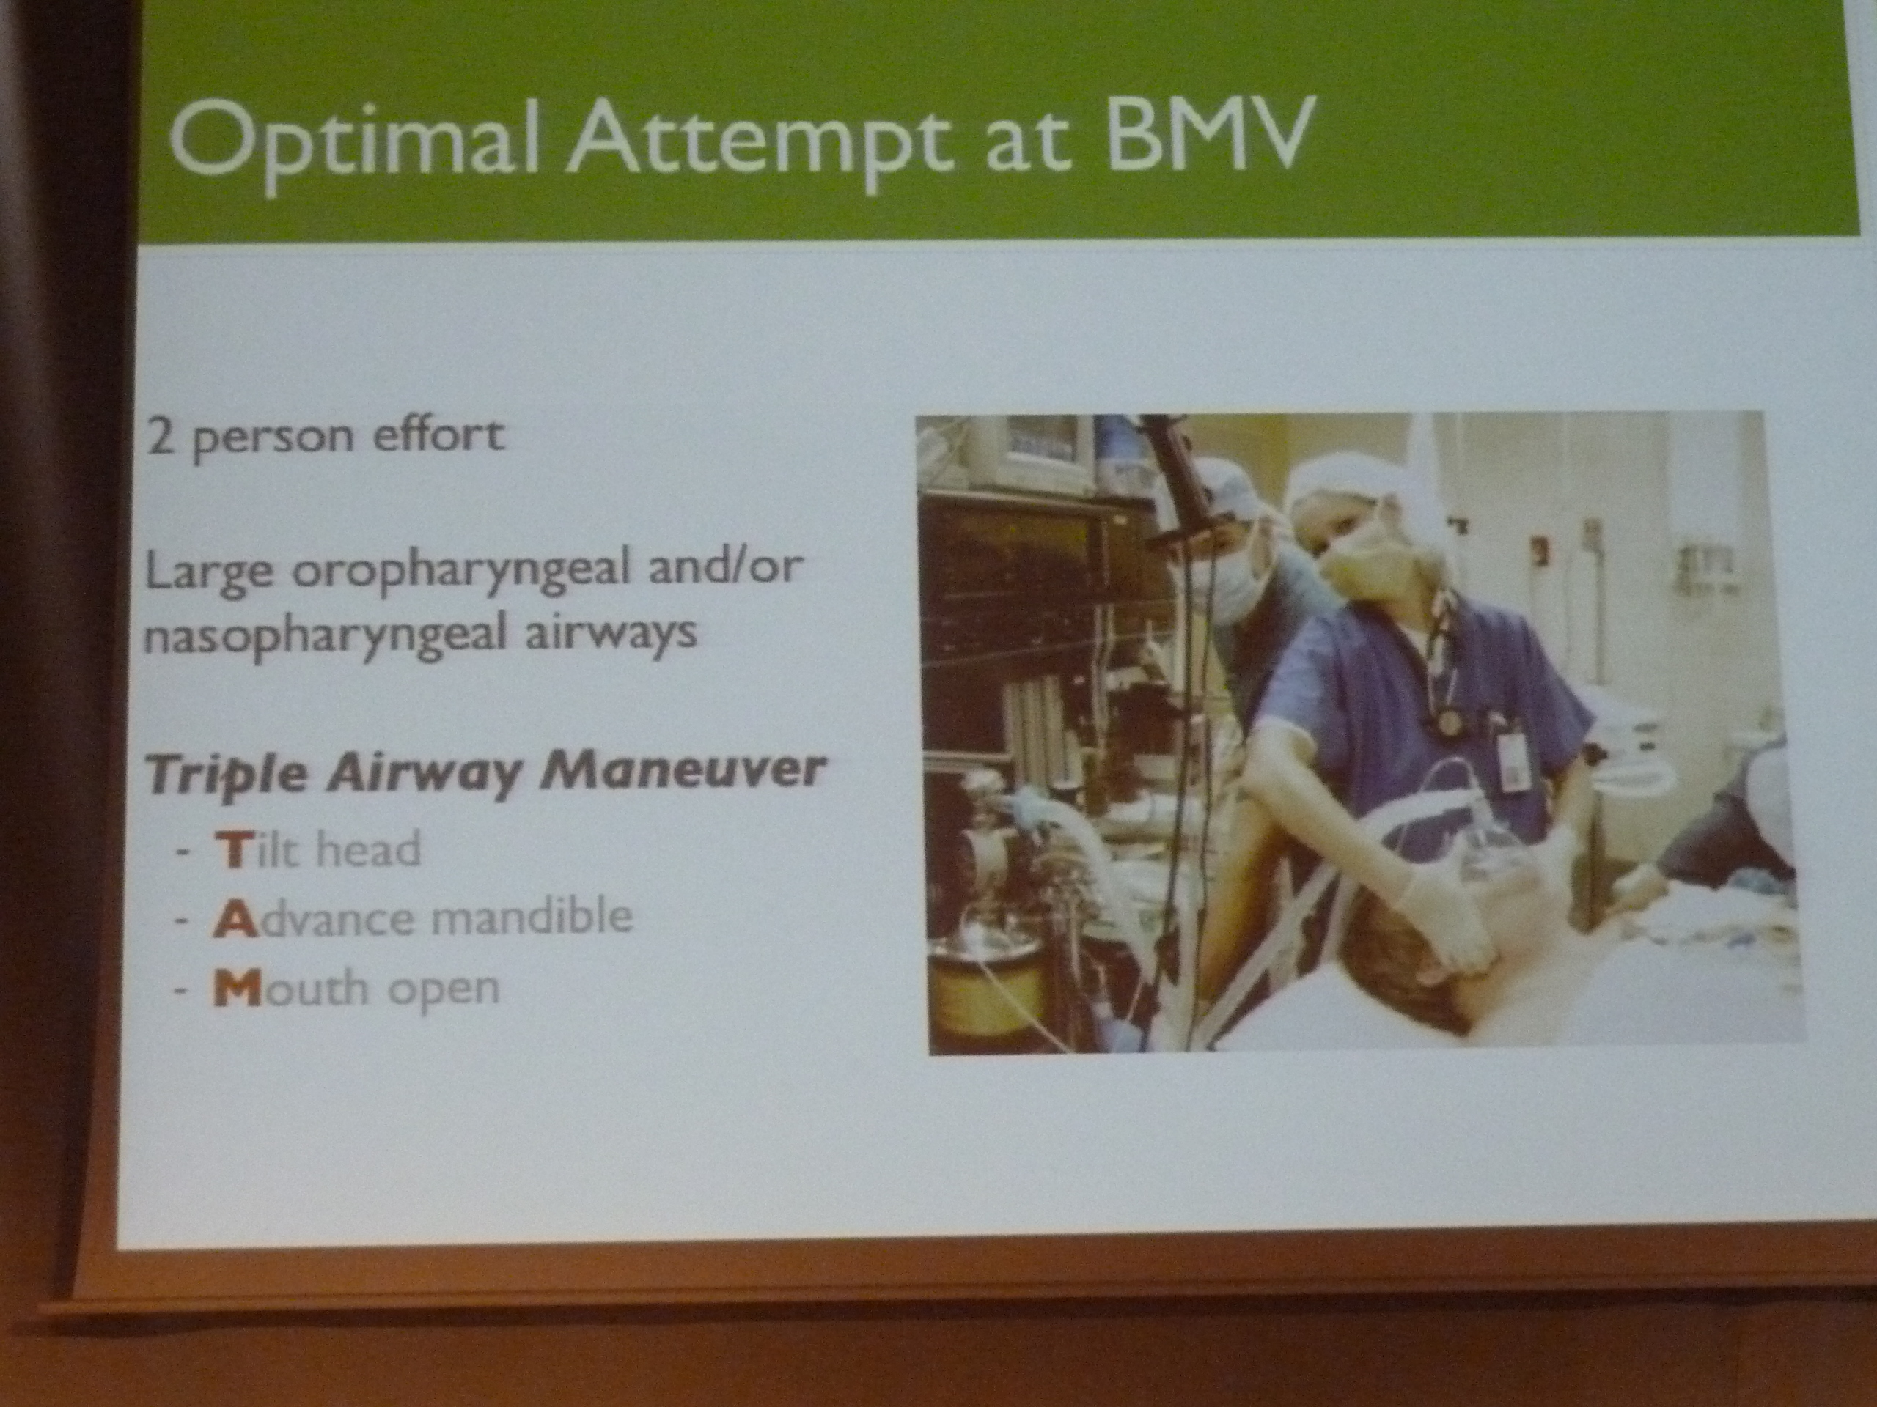

Slide 3
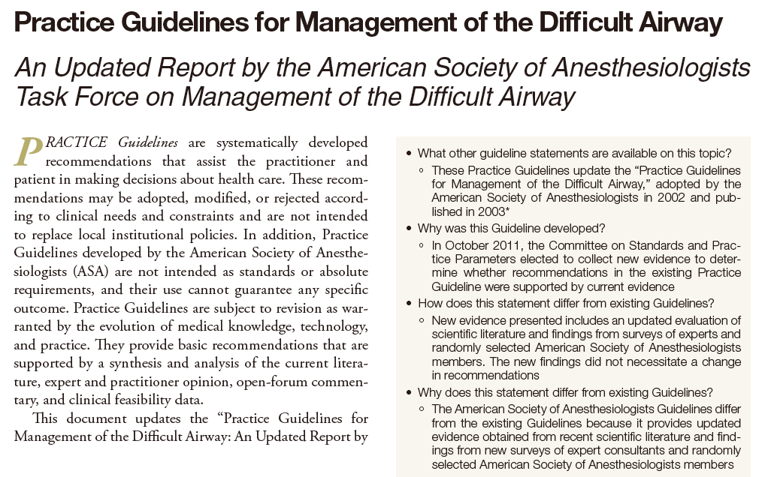

Slide 4
困難呼吸道定義
a difficult airway is defined as
  The clinical situation in which a conventionally trained anesthesiologist experiences difficulty with facemask ventilation of the upper airway, difficulty with tracheal intubation, or both.
The difficult airway represents a complex interaction between
  Patient factors,
  Clinical setting, and
  Skills of the practitioner.

Slide 5
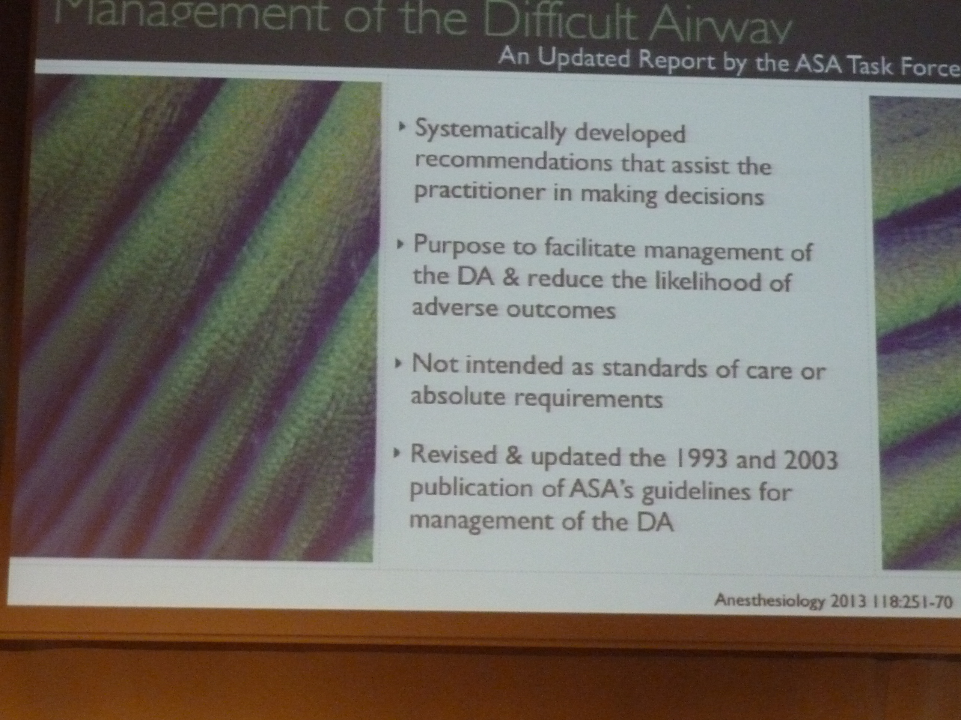

Slide 6
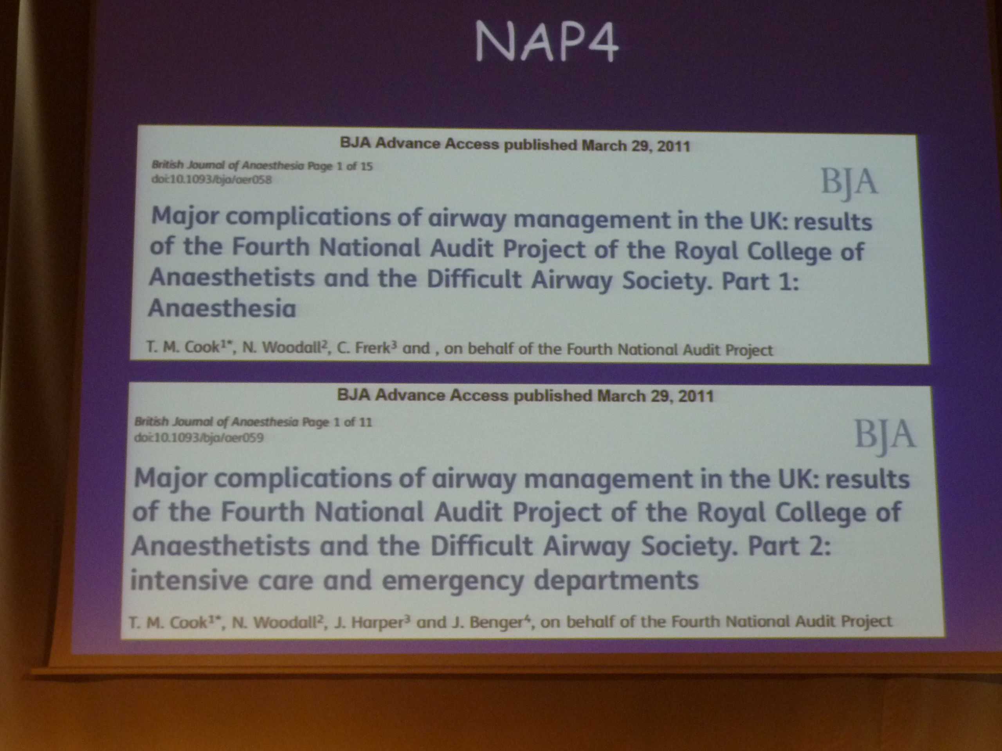

Slide 7
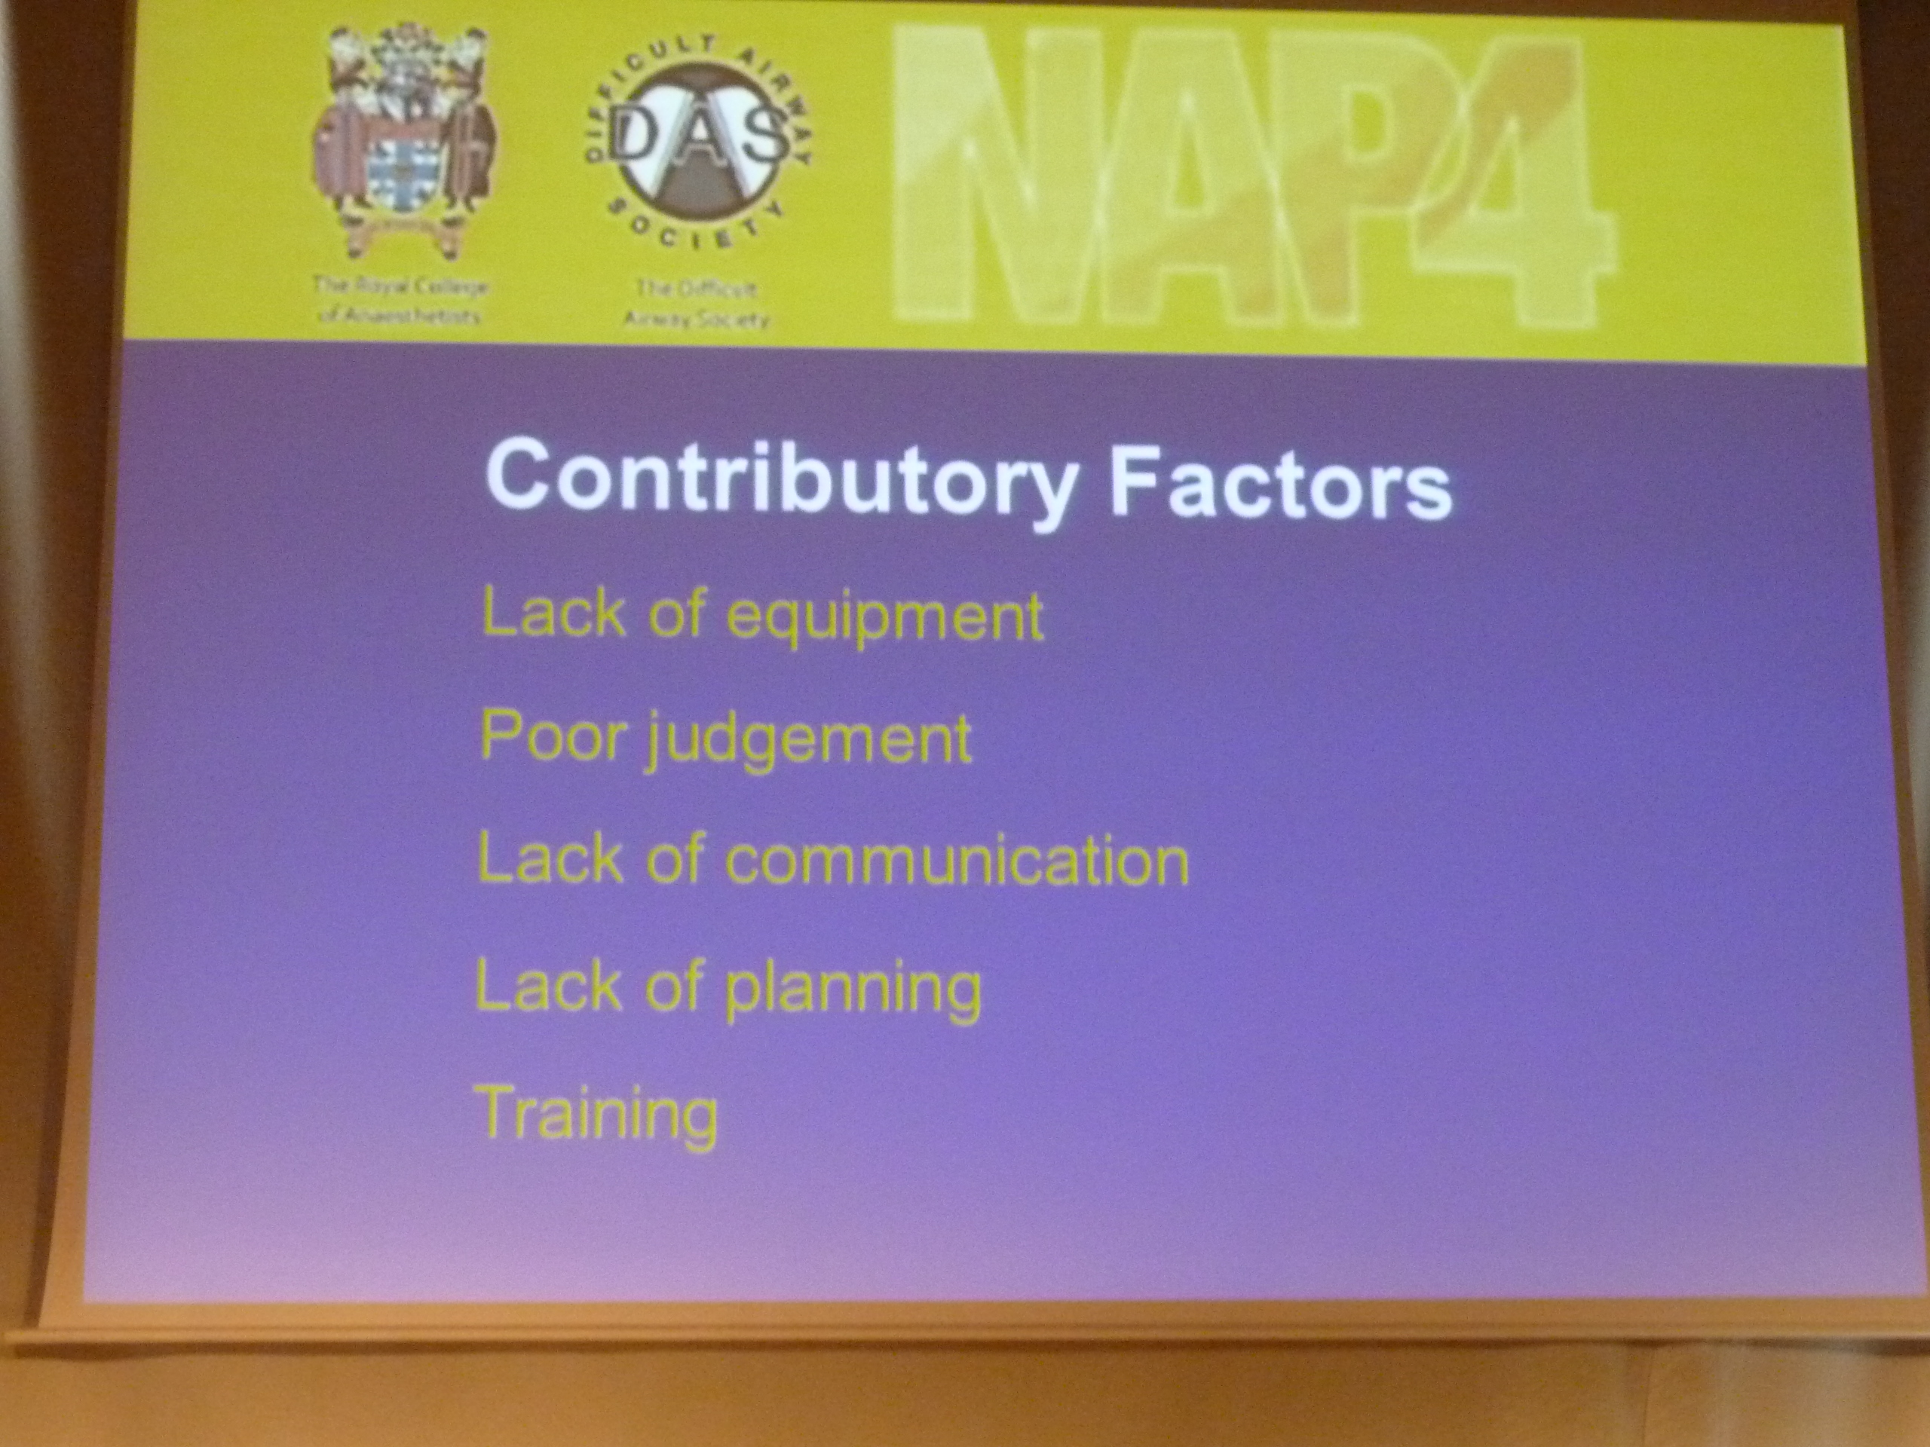

Slide 8
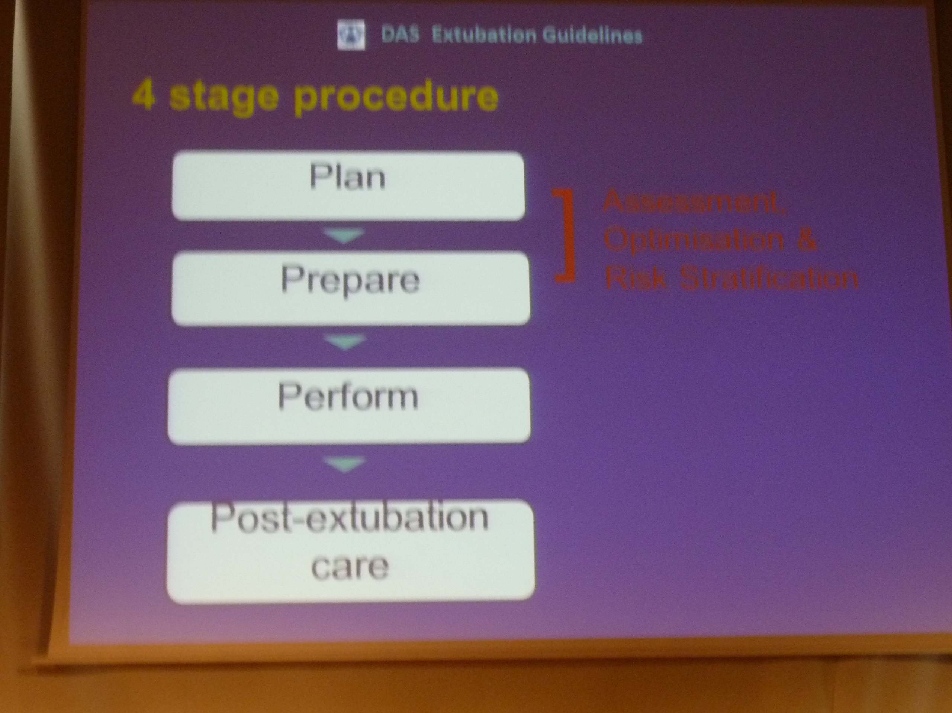

Slide 9
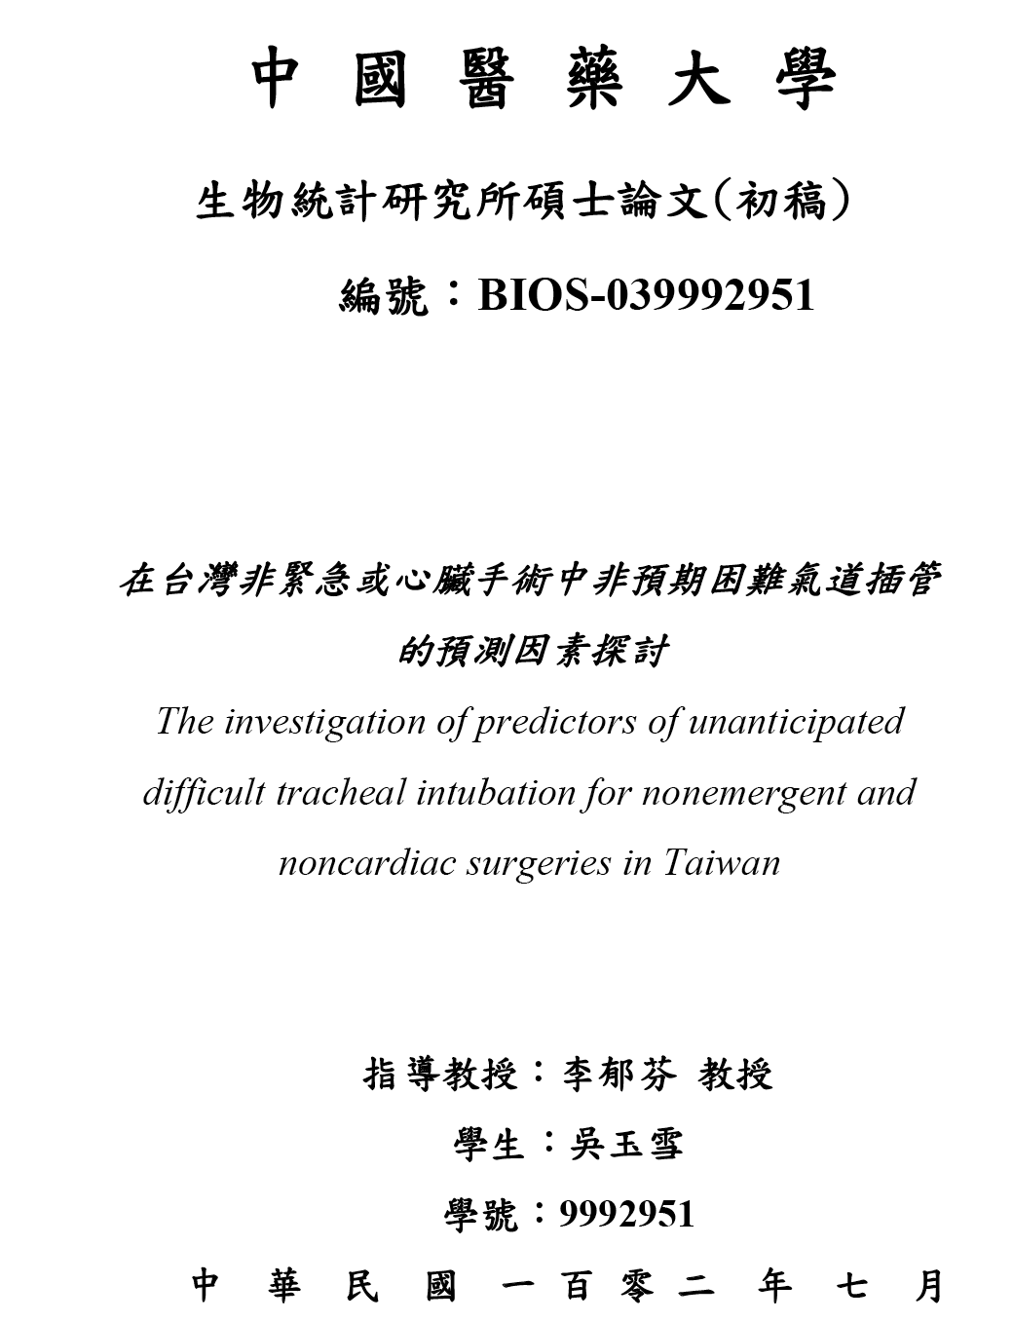

Slide 10
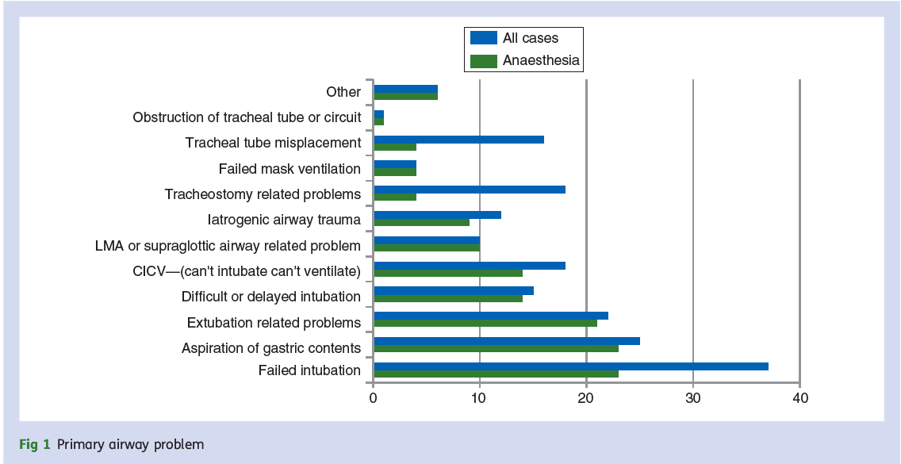

Slide 11
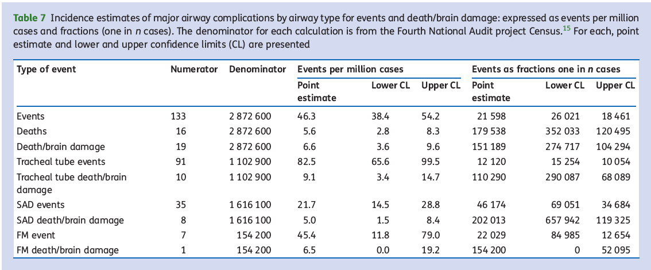

Slide 12
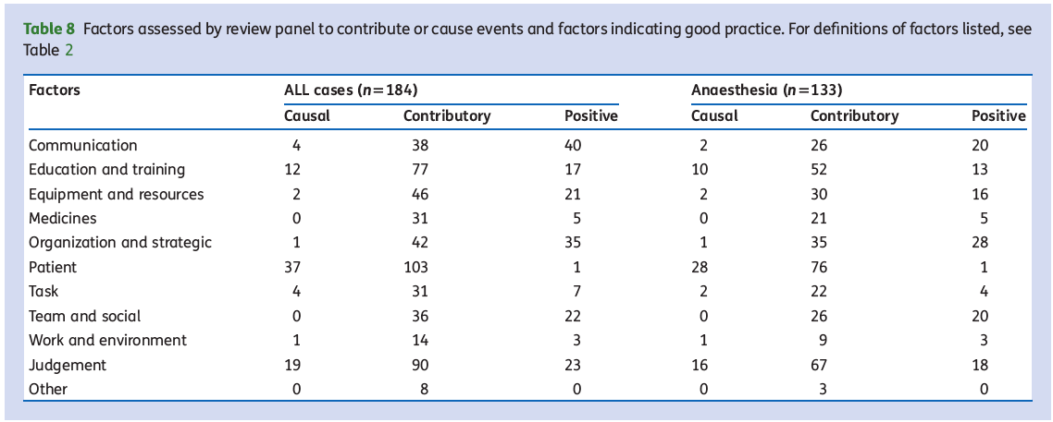

Slide 13
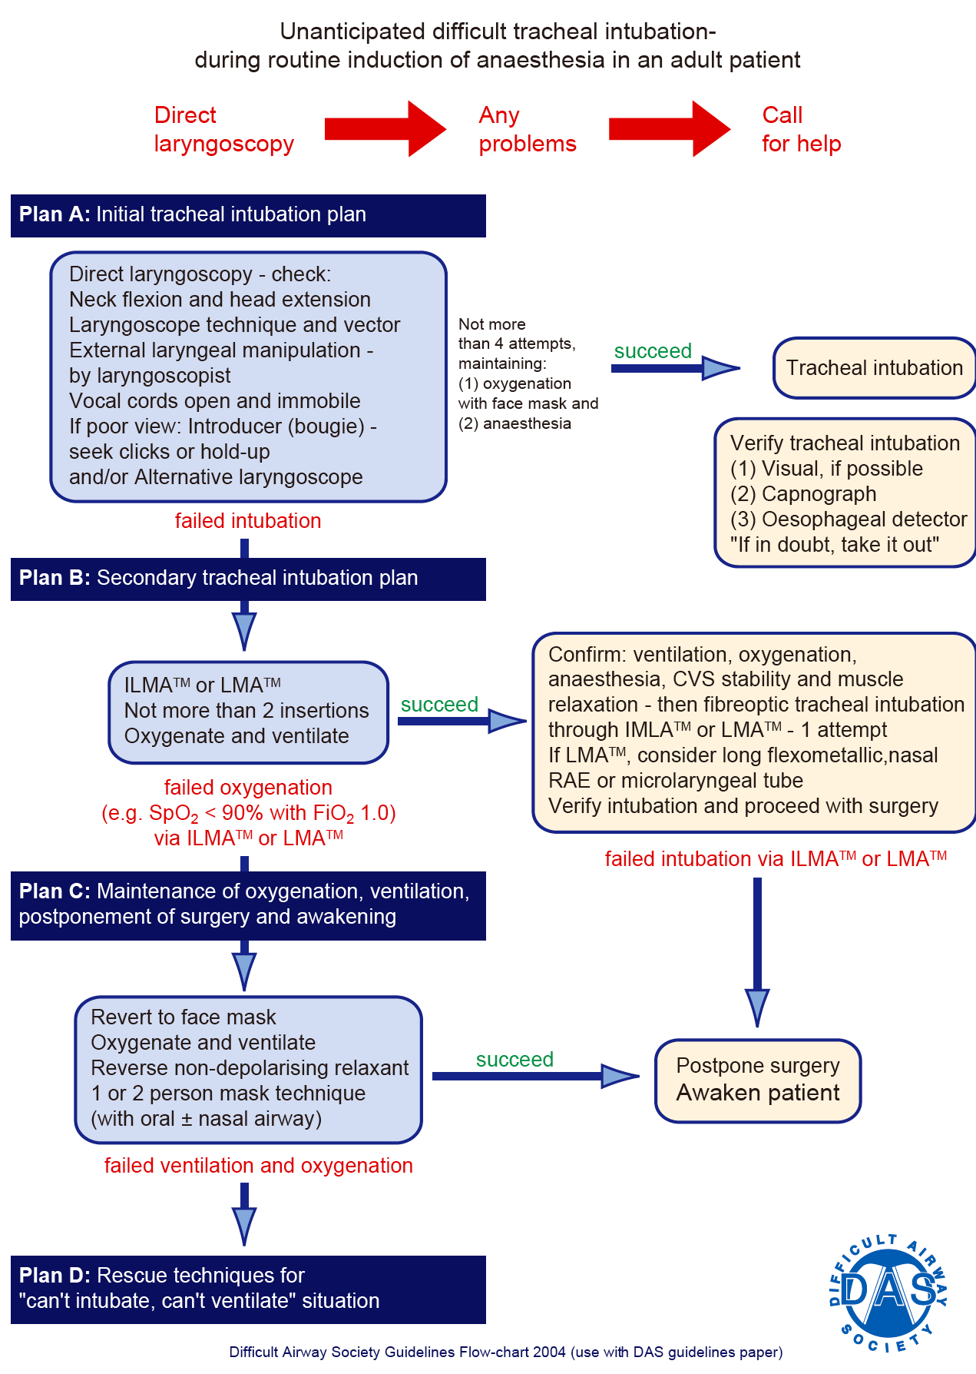

Slide 14
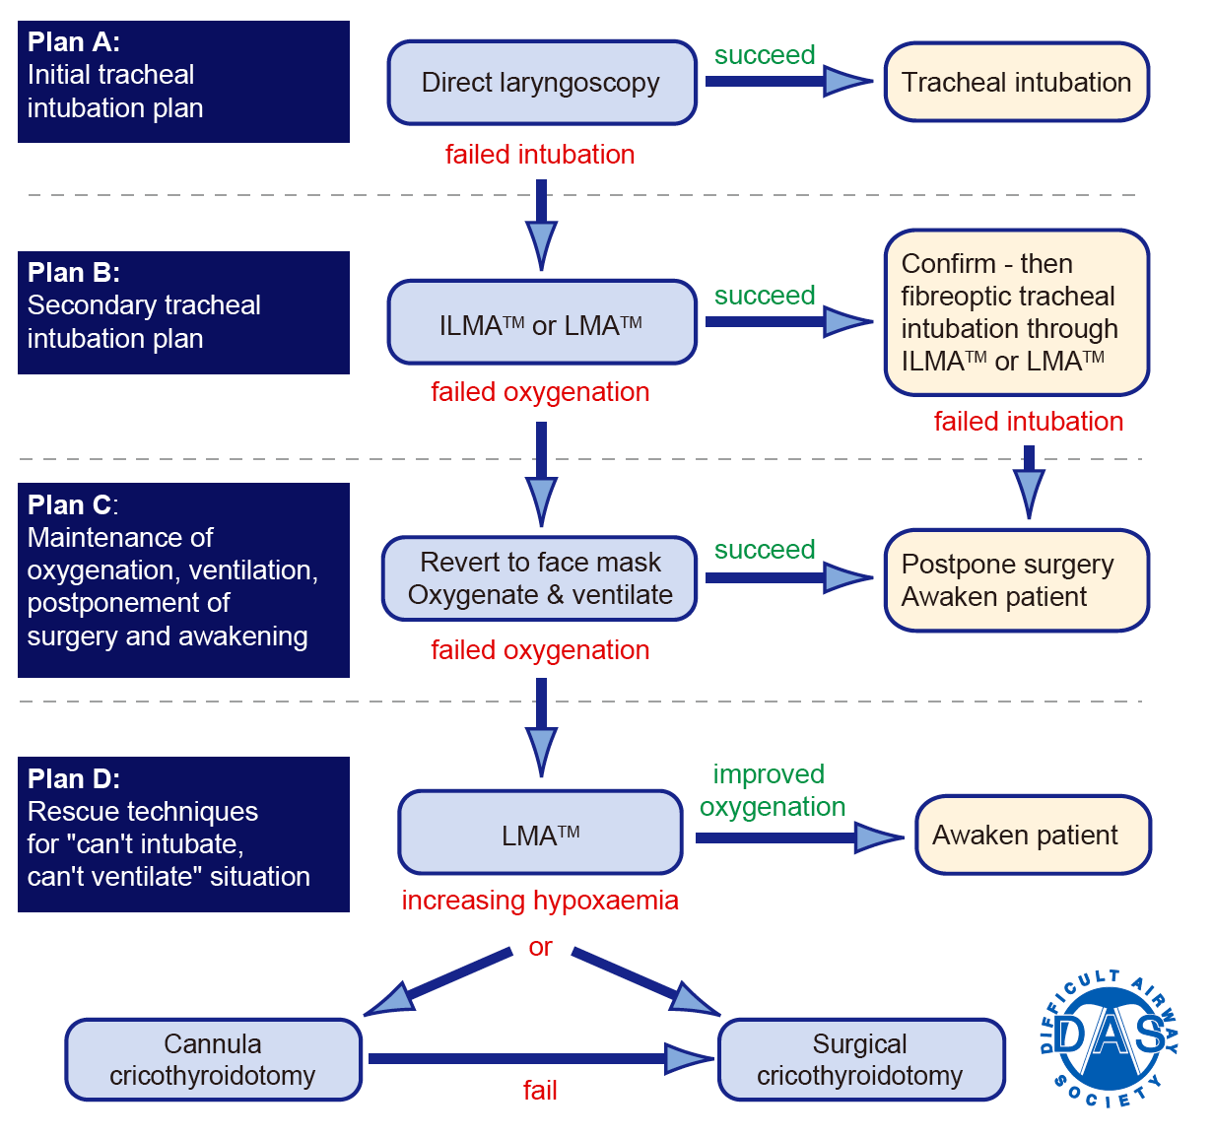

Slide 15
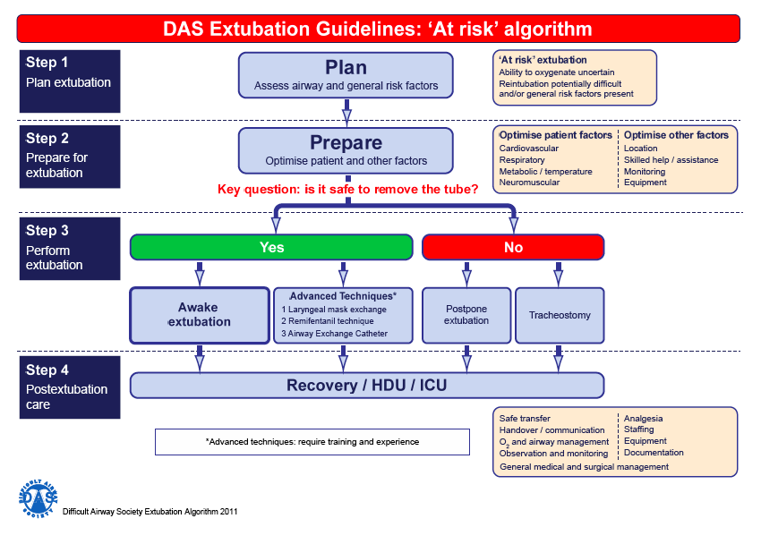

Slide 16
目前成效及規劃
帶動院內呼吸道維護安全照護
呼吸道管理教案
擬和麻醉醫學會合辦困難呼吸道訓練論壇

Slide 17
問題
評估及記錄
  Difficult mask
  Difficult Intubation
  Record
準備
  器材
  何人作何事: 麻醉醫師，醫師，護理，呼吸治療
拔管: RN＆ICU doctor
教育：Who; What; How

