Slide 1
Information
Chart No. : 08674371
75 y/o, male
C.C.: Right neck mass noted for 3 mmonths

Slide 2
Information
PE: Bil. Neck surgical scar
Bil. Neck mass and right cheek mass
Lab: WNL

Slide 3
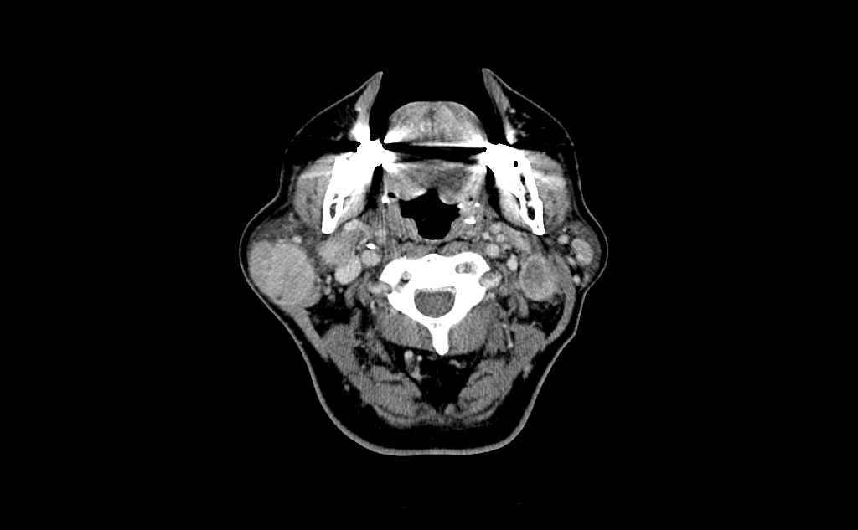
Images
2015/2/24 neck CT

Slide 4
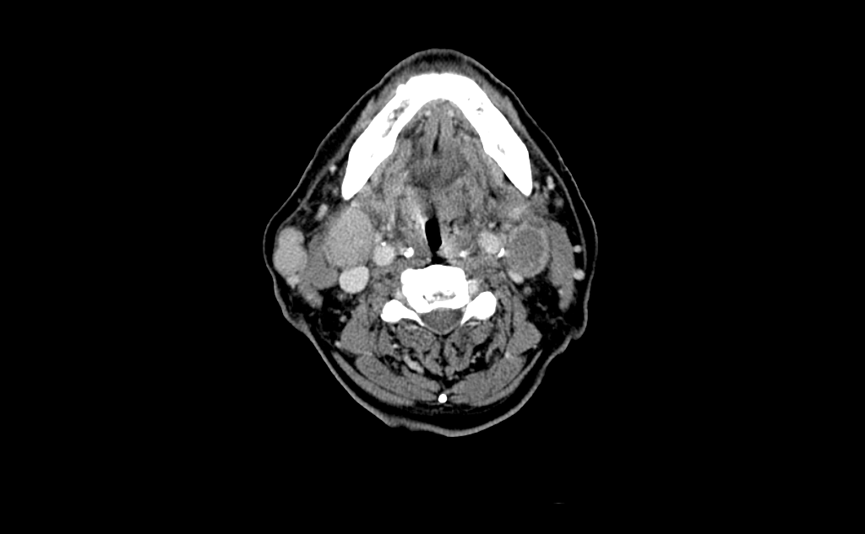

Slide 5
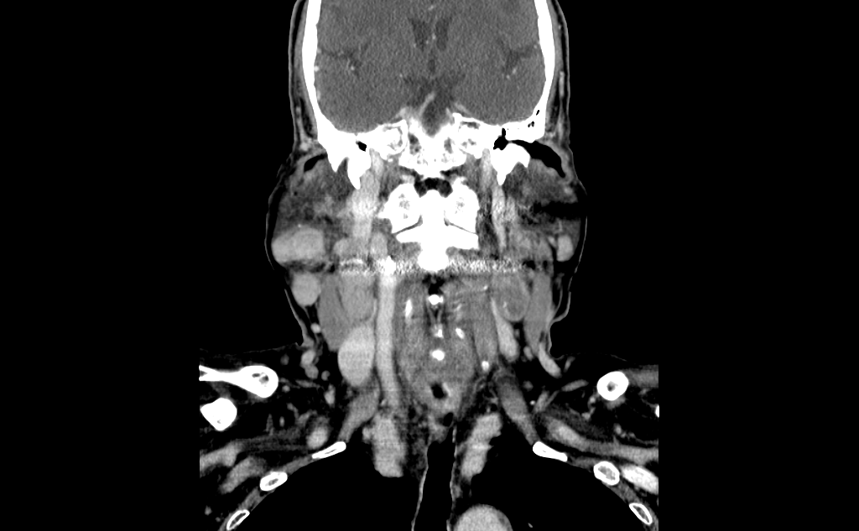

Slide 6
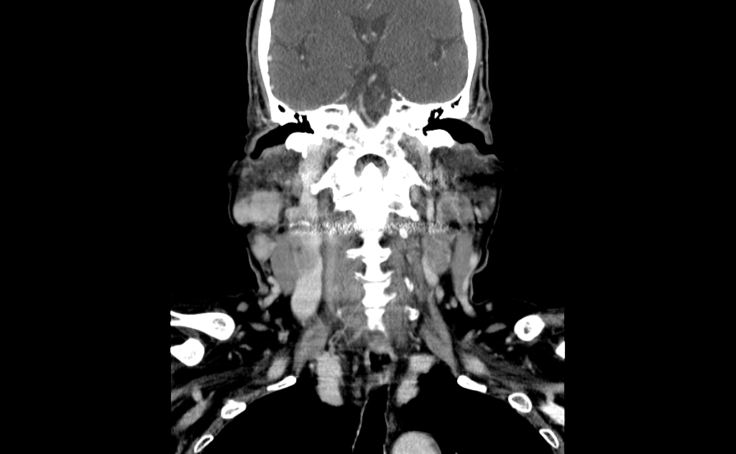

Slide 7
Radiologic findings:
Right parotid mass
Bil. Level II enlarged and necrotic
lymphadenopaty

Slide 8
D/D:
malignant :
Mucoepidermoid carcinoma
Adenoid cystic carcinoma
Salivary duct carcinoma
benign epithelial tumors
Pleomorphic adenoma
Warthin's tumor

Slide 9
Diagnosis
Pathology:
right parotid parotidectomy:
---Lymphoepithelioma-like carcinoma
Lymph nodes:
Metastatic carcinoma.

Slide 10
Discussion
Lymphoepithelioma-like carcinoma (LELC) is a medical term referring to a histological variant of malignant tumor arising from the uncontrolled mitosis of transformed cells originating in epithelia ltissue (or in cells that display epithelial characteristics) that bear microscopic resemblance to lymphoepithelioma (nasopharyngeal carcinoma).

Slide 11
There is considerable variation in the classification of LELC—while it is perhaps most commonly considered a subtype of squamous cell carcinoma, it can also be classified as a form of large cell carcinoma (i.e. when occurring in the lung), and can be considered as a separate, unique entity.

Slide 12
In most anatomical sites, many cases are associated with the Epstein-Barr virus.
In the breast, the macroscopic, microscopic, epidemiologic, and prognostic features of LELC are very similar to medullary carcinoma

